Slide 1

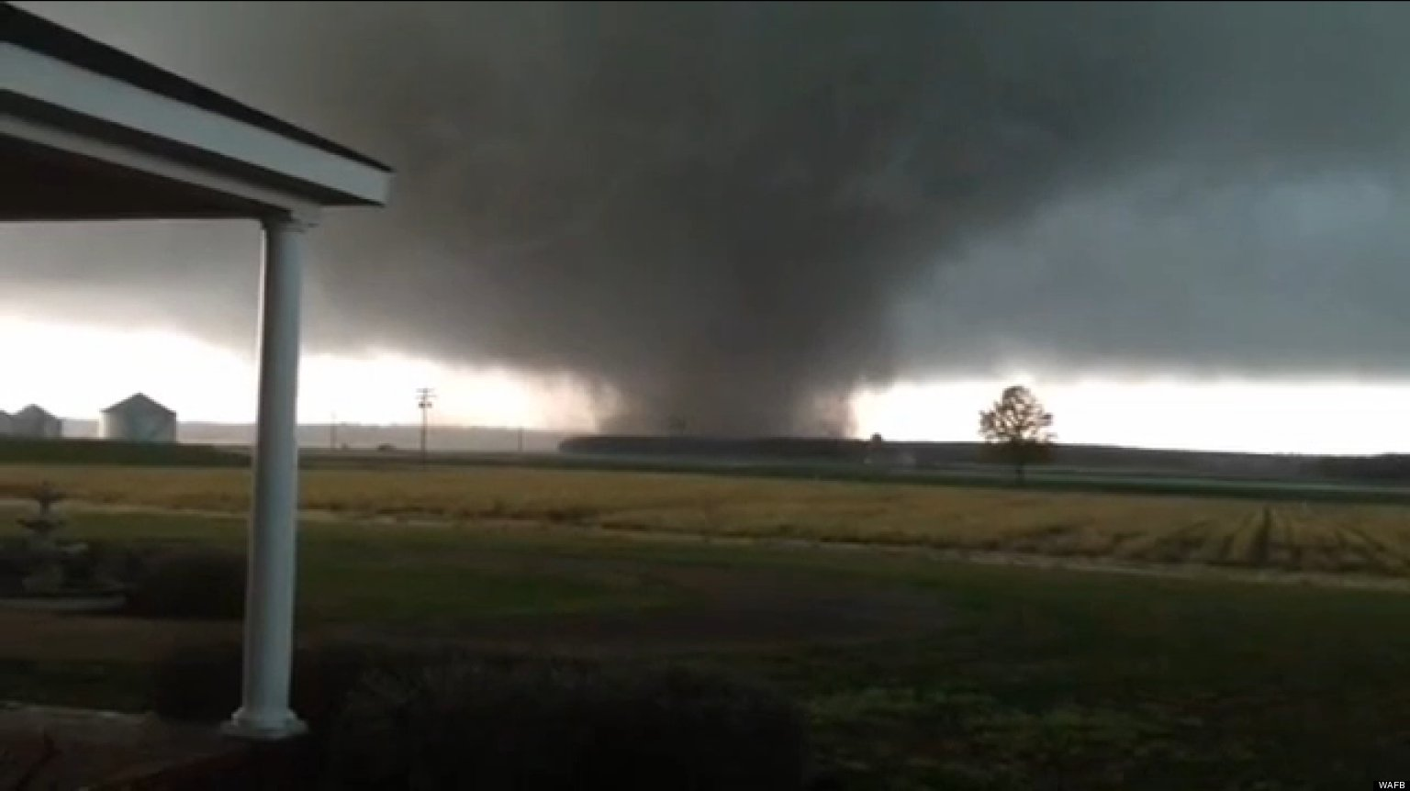

Meaning, Self-Efficacy, and Posttraumatic Growth in University Faculty and Staff:
A Study of Tornado Impact and Survivor Resilience
[Title]
[Title]
Jeffrey Pavlacic, BS, Marcela Weber, MA, Erin Buchanan, PhD, & Stefan Schulenberg, PhD
Tornado in Kemper County Mississippi, April 2013
INTRODUCTION
MEASURES
Research has suggested that meaning-making after disaster-related traumatic experiences can lead to posttraumatic growth (Dursun, Steger, Bentele, & Schulenberg, 2016; Park & Ai, 2006). Furthermore, presence of meaning prior to the disaster and meaning-making after the disaster may be key factors in building resilience (Weathers, Aiena, Blackwell, & Schulenberg, 2016). Research studies have also determined that self-efficacy is an essential variable associated with recovery from disasters (Drescher, Schulenberg, & Smith, 2014; Hirschel & Schulenberg, 2009). However, few studies exist that examine these variables (meaning, self-efficacy, posttraumatic growth) in conjunction with one another. New research is needed to examine the behaviors during disasters that are related to self-efficacy (such as providing first aid), and the experiences that are related to meaning-making and posttraumatic growth.
Considering that tornadoes are one of the most frequently-occurring disasters in the United States (National Weather Service, 2016), there is a need to examine meaning, self-efficacy, resilience, and posttraumatic growth in individuals who have experienced them.
While students say they will look to university faculty and staff during tornadoes (Tkachuck, 2016), little is known regarding tornado experiences of university employees. Thus, the purpose of this study is to examine the psychological impact of tornado experiences on university employees in a tornado-prone region.
HYPOTHESES
Greater tornado impact, resilience, and perception of meaning would be related to greater degrees of perceived posttraumatic growth.
Individuals who provided first aid after a tornado would report greater degrees of self-efficacy and posttraumatic growth.
Greater degrees of self-efficacy would be related to increased perceived preparedness for tornadoes.
Other correlations between these variables were also explored and an exploratory path analysis was conducted to examine the relationships of these variables together.
Tornado Experience
“Which of the following emergency situations have you personally experienced?”
• Tornado
• Items for 5 other disasters
“Approximately how many tornadoes have you experienced in your lifetime?”
• 1
• 2
• 3 or more
“Approximately how long has it been since the last tornado you experienced?”
• Less than a year
• 1 to 2 years
• 3 to 5 years
• More than 5 years
Tornado Impact
α_{sample} = .66
With regard to the most recent tornado, which of the following did you experience as a result of this event?
Saw others injured or killed
Got injured yourself
Felt a direct threat to your life
Provided First Aid
Lost a significant amount of material possessions
Could not get in touch with other family members
Were separated from members of your immediate family
Could not get to a store for three or more days
Lost electricity for three or more days
Were forced to leave your community or neighborhood due to an evacuation order
Had to leave home for three or more days
Had to leave work/school
Tornado Self-efficacy
“How sure are you that you know what to do if the following situations [tornado listed] were to occur at Ole Miss?”
• 7-point Likert-type response
“How confident are you in providing guidance to students in the event of the following situations [tornado listed]?
• 7-point Likert-type response
General Self-Efficacy Scale (GSES)
α_{sample} = .90
α_{scale} = .70 (Schwarzer, 2002)
Meaning in Life Questionnaire – Presence subscale (MLQ-P)
α_{sample} = .90
α_{scale} = .82(Steger et al., 2006)
Brief Resilience Scale (BRS)
α_{sample} = .88
α_{scale} = .87 (Smith, et al., 2010)
Posttraumatic Growth Inventory (PTGI)
α_{sample} = .96
α_{scale} = .87 (Cann, et al., 2010)
Participants were asked specifically about growth following their most recent tornado experience.
Disaster Preparedness Behavior
Are you aware of the safe areas in the buildings you frequent on campus?
Yes or No
Which of the following emergency preparedness measures have you taken?
Currently certified in First Aid/CPR training
Have received Psychological First Aid (PFA) training
Participated in an interactive weather drill in the past 6 months
Downloaded a smart phone app for use other than checking the weather reports (e.g. weather notifications, general emergency preparedness information, etc.)
DISCUSSION
RESULTS
Our study corroborates Park and Ai’s model (2006) of meaning-making as a process for building posttraumatic growth following a tornado, specifically with regard for spiritual growth and appreciation of life. Our findings also suggest that self-efficacy may be either a cultivating factor or a positive outcome of aiding and assisting others during a tornado. Lastly, the relationship between perceived threat to life and appreciation of life exemplifies the specific way a traumatic experience can be transformed meaningfully.
Additionally, we conducted an exploratory path analysis to examine the predictive nature of the hypothesized relationships between our variables in our study of university employees. We calculated the following fit indices in order to examine model fit: X²/df ratio, Root Mean Square Residual (RMSEA), Comparative Fit Index (CFI), and Standardized Root Mean Square Residual (SRMR). The model demonstrated good fit for both CFI and SRMR and acceptable fit for RMSEA. Our model is a replication of the student data also collected for this project. Higher presence of meaning in life scores predicts both higher resilience and posttraumatic growth. Higher resilience scores predict higher disaster preparedness. Finally, higher tornado impact predicts both disaster preparedness and posttraumatic growth.
Resilience
(BRS)
.06
Disaster Preparedness
.02
Posttraumatic growth
Tornado Impact
Meaning (PIL-SF)
.14
.43
.07
df = 24
X² = 50.66
CFI = .974
SRMR = .045
RMSEA = .074
F1
F2
F3
F4
F5
PARTICIPANTS
About half the employees taking part in the survey had experienced at least one tornado (n = 225).
Participants (N = 448) were faculty (37.7%) and staff (62.3%) who were employed at a university in a tornado-prone region in the spring semester of 2016. 39.0 percent identified as male and 61.0 percent identified as female. 87.6 percent identified as White non-Hispanic/Latino, 5.2 percent as Black, and 7.2 percent as another race or ethnicity.
Significant (p < .05) scale correlations:
Significant (p < .05) correlations between tornado impact and posttraumatic growth:
 | GSES | BRS | Posttraumatic Growth (PTGI-SF)
Meaning (MLQ-Presence) | r = .21 | r = .25 | r = .14
General Self-Efficacy (GSES) | (1) | r = .50 | ---
 | Tornado Impact Sum
PTGI-Sum | r = .24
PTGI-F1 – Relating to Others | r = .23
PTGI-F2 – New Possibilities | r = .17
PTGI-F3 – Personal Strength | r = .25
PTGI-F4 – Spiritual Change | r = .18
PTGI-F5 – Appreciation of Life | r = .28
REFERENCES
PROCEDURE
Significant (p < .05) correlations with tornado impact items, tornado self-efficacy, and general self-efficacy:
For a complete list of references, please refer to the handout.
 | GSES
Provided First Aid during a tornado | r = .13
Perceived a direct threat to one’s life | r = .15
Confident guiding students during a tornado | r = .31
Sure they know what to do during a tornado | r = .22
ACKNOWLEDGEMENTS
Faculty and staff at a university in a tornado-prone area participated in a 10-minute online survey. They were recruited via a link on the university news webpage and a mass email sent to all university employees.
An additional exploratory finding of note was that surviving a perceived direct threat to one’s life was significantly correlated with Appreciation of Life (r = .14).
We would like to thank the University of Mississippi Incident Response Team (IRT) for sponsoring this research.

